Slide 1
Java
Writing a Program

Slide 2
Syntax
Class
class Class_Name
{
// instance variables & methods
}
Object
There are three steps when creating an object from a class:
Declaration − A variable declaration with a variable name with an object type.
Instantiation − The 'new' keyword is used to create the object.
Initialization − The 'new' keyword is followed by a call to a constructor. This call initializes the new object.
Any number of objects can be created using new() operator
Class_Name object_name = new Class_Name();
Main Method
public static void main(String [] args) { // statements }

Slide 3
Allocating Memory to Objects
Any number of objects can be created of type class using new() operator.
Syntax:
classname objectname = new classname();

Slide 4
Accessing Object Variables & Methods
The variables and methods of a class are available to all the objects of that particular class
Variables and methods inside a class are accessed using dot operator
Accessing Instance variable
object_name . instance_variable;
Accessing methods
object_name . method();

Slide 5

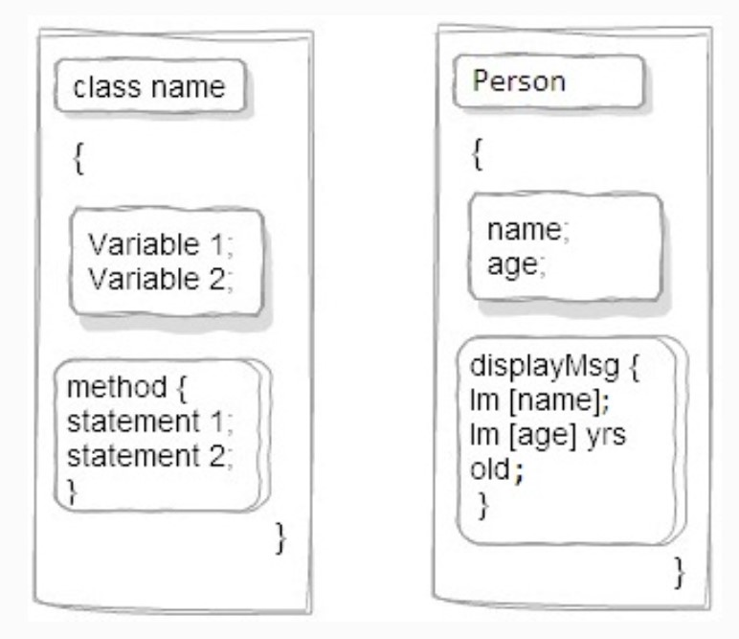
Example
class Person
{
int age;
String name;
public void displayMsg()
{
System.out.println ("Im " + name );
System.out.println ("Im " + age + " years old");
}
public static void main(String args[])
{
Person e1 = new Person(); //object creation
e1.age = 20; //accessing fields
e1.name = “Anu”;
e1.display_Msg(); //accessing methods
}
}

